Slide 1
ABAP Part II
Lesson 03: File Handling

Slide 2
Lesson Objectives
After completing this lesson, participants will be able to know -
File Handling Application Server
File Handling Presentation Server

Slide 3
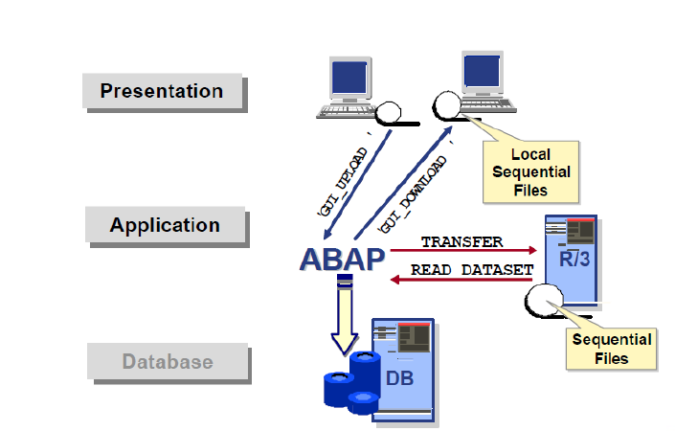
Introduction

Slide 4
Introduction
File is a place where information or data is stored. File handling in simple terms is opening, closing, reading, writing, deleting, copying, renaming the files.
The runtime environment is implemented on the application server, which executes the ABAP programs. ABAP supports the file transfer (data transfer) technique to the application server and the front end hosts.
The interface to the file system on the application server is implemented in the form of ABAP language elements.
You can process sequential files using various file-handling methods and procedures to read data, process data and transfer it into SAP system. These files act as data source and these methods ensure consistency of the data in SAP R/3 system.

Slide 5
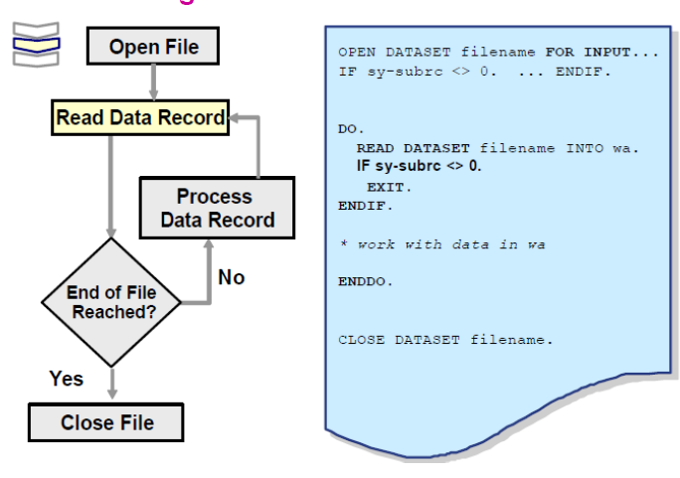
File Handling on Application Server
Overview Diagram – Read File

Slide 6
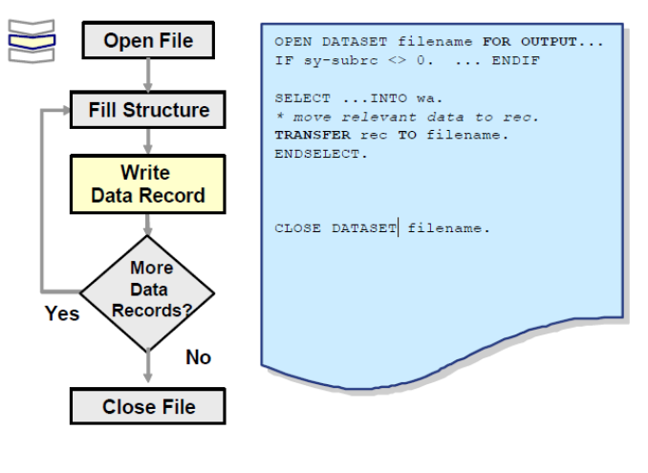
File Handling on Application Server
Overview Diagram – Write File

Slide 7
File Handling on Application Server
ABAP/4 provides five statements for handling files:
OPEN DATASET
CLOSE DATASET
DELETE DATASET
READ DATASET
TRANSFER

Slide 8
File Handling on Application Server
Open Dataset
Opens the specified file. If you do not use any additions, the file is opened for reading in binary mode. It returns SY-SUBRC = 0 if the file is opened successfully. Otherwise SY-SUBRC = 8.
Syntax
OPEN DATASET <DSN> [Additions].
Notes:
Additions:
1. FOR INPUT ( Default )
2. FOR OUTPUT
3. FOR APPENDING
4. IN BINARY MODE
5. IN TEXT MODE
6. AT POSITION p
7. TYPE ctrl
8. MESSAGE mess
9. FILTER f

Slide 9
File Handling on Application Server
OPEN DATASET <DSN> FOR INPUT.
This statement tries to open the field in 'read/update' mode (as long as the user has write authorization).If the user does not have write authorization, the system opens the file in 'read' mode. If this fails, an error occurs.
OPEN DATASET <DSN> FOR OUTPUT.
This statement tries to open the file in 'write/update' mode as long as the user has read authorization. If the authorization is missing, the system opens the file in 'write' mode. If the file already exists, its existing content is deleted. If the file does not exist, the system creates it.
OPEN DATASET <DSN> FOR APPENDING.
This statement tries to open the file in 'append' mode. If the file is already open, the system moves to the end of the file. When you open a file using FOR APPENDING, attempting to read the file sets SY-SUBRC to 4. The system display the end of the file.
Note : You can only use one of the additions 1 to 3 in a single statement.
Notes:
OPEN DATASET <DSN> IN BINARY MODE.
The contents of the file are not structured in lines in the READ DATASET or TRANSFER operations. Instead, they are input or output as a stream. You do not have to specify the IN BINARY MODE addition explicitly.
OPEN DATASET <DSN> IN TEXT MODE.
If you use this addition, the contents of the file are structured in lines. Each time you use the READ DATASET or TRANSFER statement, the system reads or writes a single line. If the data object to which you are transferring the data is too big, it is padded with spaces. If it is too small, the data record is truncated.
Note : You can only use one of additions 4 and 5 in a single statement
OPEN DATASET <DSN> AT POSITION p.
Use this addition to specify the explicit starting position p in the file (calculated in bytes from the start of the file). The next read or write operation will start at this position. You cannot position before the beginning of the file. Do not use this addition with the IN TEXT MODE addition, since the physical representation of a text file depends heavily on the underlying operating system.
If you use OPEN ... FOR OUTPUT AT POSITION ..., the contents of the file are destroyed if the file already existed. To avoid this, use OPEN ... FOR INPUT AT POSITION ... instead.
Note: OPEN ... AT POSITION p does not work for file positions where p >= 2 Gigabytes.
OPEN DATASET <DSN> TYPE ctrl .
You can use the ctrl field to specify further file attributes. The contents of this field are passed unchanged and unchecked to the operating system. The syntax for the attributes is dependent on the operating system.
OPEN DATASET <DSN> MESSAGE msg.
If an error occurs while the file is being opened, the corresponding operating system message is placed in field msg.
Example
DATA: DSN(20) VALUE '/USR/TEST.DAT', MSG(100). OPEN DATASET DSN FOR INPUT MESSAGE MSG. IF SY-SUBRC <> 0. WRITE / MSG. ENDIF.
OPEN DATASET <DSN> FILTER f.
If you are working under UNIX or Windows NT, you can specify an operating system command in the field f.
Example Under UNIX, the following statements opens the file DSN and writes the data to the file in compressed form because of the UNIX command 'compress' :
DATA DSN(20) VALUE '/USR/TEST.DAT'.
OPEN DATASET DSN FOR OUTPUT FILTER 'COMPRESS'.

Slide 10
File Handling on Application Server
CLOSE DATASET
Closes the specified file.
Syntax CLOSE DATASET <DSN>.
DELETE DATASET
Deletes the file specified file. If it deletes the file successfully it returns SY-SUBRC = 0. Otherwise returns SY-SUBRC = 4. The possible reasons for failing are:
The file does not exist
The file is a directory
The file is a program that is currently running

Slide 11
File Handling on Application Server
READ DATASET
Used to read a record from a file.
Syntax
READ DATASET DSN INTO F.
Addition : LENGTH LEN.
The actual length of the data objet read is placed in the field LEN after the read access. LEN must be defined as a variable. A syntax error will occur if you define it as a constant. The following example displays 9.
Notes:
Example
DATA: LEN TYPE I,
TEXT(30) TYPE C VALUE 'BEETHOVEN',
DIR(30) TYPE C VALUE '/USR/TEST.DAT'.
OPEN DATASET DIR IN TEXT MODE.
TRANSFER TEXT TO DIR.
CLOSE DATASET DIR.
OPEN DATASET DIR IN TEXT MODE.
READ DATASET DIR INTO TEXT LENGTH LEN.
CLOSE DATASET DIR.
WRITE / LEN.

Slide 12
File Handling on Application Server
TRANSFER
Used to write a record into a file.
Syntax
TRANSFER F TO DSN.
Transfers the data object f to a sequential file whose name is specified in DSN. DSN can be a field or a literal. You must already have opened the file. . If the specified file is not already open, TRANSFER attempts to open the file FOR OUTPUT IN BINARY MODE. If this is not possible, a runtime error occurs f can be a field, a string, or a structure.
Addition : LENGTH LEN.
The length of the data object to be written is defined by LEN, where LEN can be either a constant or a variable. If LEN is smaller than the length of the data object f, the system truncates character fields (C, N, D, T, X,P, STRING) on the right. With type I or F fields, unexpected results may occur if LEN is shorter than the default length for the field type

Slide 13
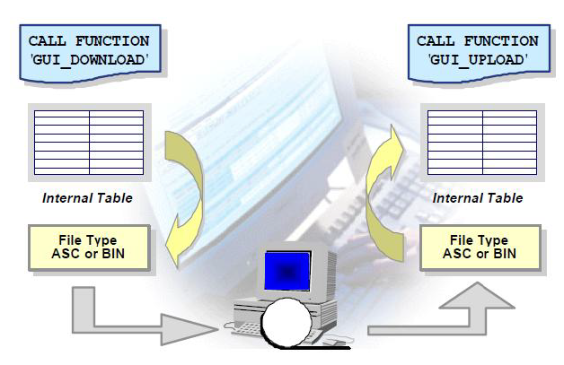
File Handling on Presentation Server
To work with files on the presentation server , SAP provides some special function modules GUI_UPLOAD, for reading from a file, and
GUI_DOWNLOAD, for writing into the file. An internal table must be used as an interface between the program and the function module

Slide 14
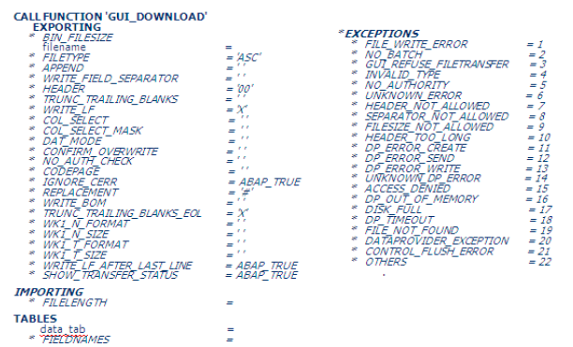
File Handling on Presentation Server
GUI Download - Signature
Writing data to a file on the presentation server:
To write data from an internal table to a file on the presentation server, use function module GUI_DOWNLOAD.
The most important parameters that are exported are as follows:

Slide 15
File Handling on Presentation Server
Some of the important parameters that are exported are as follows:
BIN_FILESIZE - File Length for binary files. A length of zero or the length which is larger than the number of bytes in the internal table (width * number of lines) causes an exception.
FILENAME - The name of the file that is to be generated on the presentation server( if necessary with predefined path name). If the path doesn’t exist or the file cannot be opened, an exception will be raised.
APPEND - By default, existing local files are overwritten by new versions. By setting APPEND to 'X', the downloaded data is appended to an existing file. If the file does not yet exist, it is created.
CONFIRM_OVERWRITE - If this parameter is set, a file is overwritten only after a confirmation by the user
FILELENGTH - Number of bytes transferred
Tables Parameter - DATA_TAB
The source internal table whose contents are downloaded into a file.
Notes:
FILETYPE - The target format of the file. Valid values are:
‘ASC’ : ASCII format, the table is stored with rows.
‘DAT’: ASCII format as in 'ASC', additional column separation with TABs.
‘BIN’ : Binary format (specification of BIN_FILESIZE required)
‘DBF’ : Stored as Dbase file (always with DOS code page).
‘IBM’ : ASCII format as in 'ASC' with IBM code page conversion (DOS)
‘WK1‘ : Data is downloaded in Lotus 1-2-3 format

Slide 16
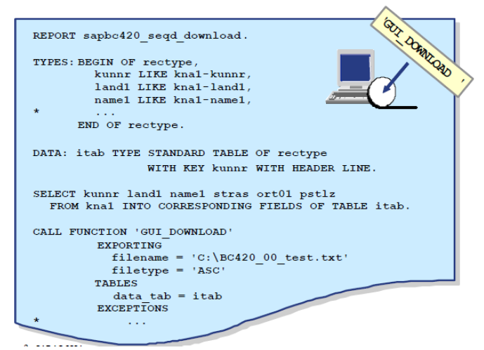
File Handling on Presentation Server
Example of GUI_DOWNLOAD

Slide 17
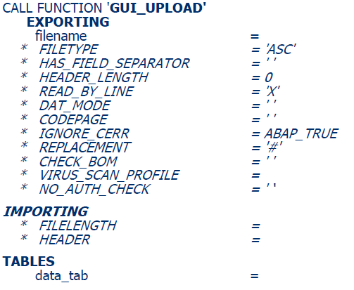
File Handling on Presentation Server
GUI Upload - Signature
Reading data from a file on the presentation server:
To read data from the presentation server into an internal table we use the function module GUI_UPLOAD. The most important parameters that are exported are as follows

Slide 18
File Handling on Presentation Server
GUI Upload - Signature
Some of the exporting parameters
FILENAME - Name of the file
FILETYPE - The source file type. Valid values are:
‘BIN’ : Binary files.
‘ASC’: ASCII files, text files with end-of-line markers.
‘DAT’: The file is loaded line by line into the transferred table. Tabs in the file mean a change of field.
HAS_FIELD_SEPARATOR: Specifies if the fields in the file are separated by a tab. This is necessary if the structure passed contains several components. CR/LF occurs instead of a tab after the last field of a row

Slide 19
File Handling on Presentation Server
GUI Upload - Signature
Importing Parameter
FILELENGTH : Number of bytes transferred.
Table parameter
DATA_TAB : Internal target table, to which the data is loaded.
Exceptions
CONVERSION_ERROR - Errors in the data conversion.
FILE_OPEN_ERROR - System cannot open file.
FILE-READ_ERROR - System cannot read from file
INVALID_TABLE_WIDTH - Invalid table structure
INVALID_TYPE - Invalid value for parameter FILETYPE

Slide 20
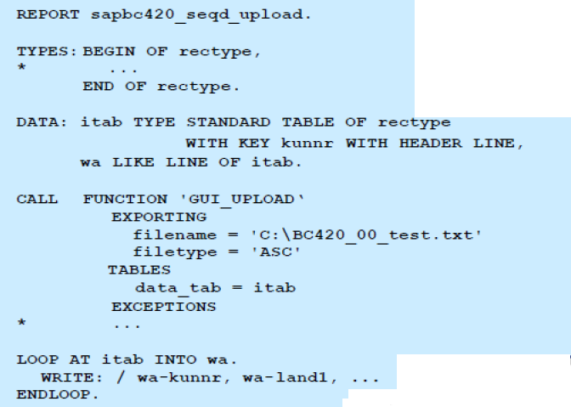
File Handling on Presentation Server
GUI Upload - Example

Slide 21
File Archiving
Need: Many a times file cannot be deleted after processing is complete. There are certain implications due to government regulations, taxation (IRS) regulations, FDA requirements, internal organizational requirements, and audit requirements.
Method: As against standard SAP archiving way, one can archive processed file by moving it to a pre-defined folder on the application server. In future if need arise one can retrieve the file from archive folder.

Slide 22
Summary
In this lesson, you have learnt:
Reading files from Presentation Server
Reading files from Application Server

Slide 23
Review Question
Question 1: If the dataset is opened in write mode and the If the file already exists, its existing content is deleted.
True/False
Question 2 A File can be opened for Output and Read at the same time.
True/False

